Slide 1




CPO Key Modules: Silicon Photonics Chip, Electrical IC, Switch ASIC, and Integration & Delivery
Input/Output
① Optical Signal Hub
② Electrical Signal Hub
③ Switch Chip
External Light
Routing + Conversion (Optical ↔ Electrical)
Amplification + Optimization
Control + Signal Processing
④ Integration¹: Advanced Packaging + System Integration
Interposer
Silicon Photonics Chip
(SiPh)
​Electrical IC
(EIC)​
ASIC
Fiber
Laser
¹Note: Foundry not included.

Slide 2








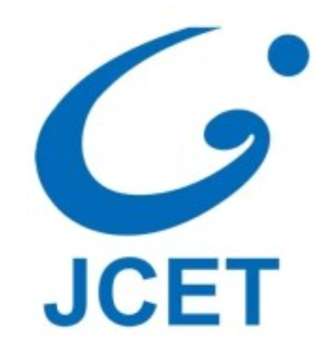
Supply Chain: EICs & Switch Chips - Large Scale, High Margin, Long R&D
① Optical Signal Hub
② Electrical Signal Hub
③ Switch Chip
④ Integration
Market Size¹（2028E）
$bn
CAGR: 40+%
$bn
CAGR: 20+%
$bn
CAGR: 10+%
$bn
CAGR: 15+%
BOM
10-20%
20-30%
20-30%
10-20%
Gross
Margin
40%
50-70%
40-70%
10-50%
R&D Cycle
Over-
seas
5y
2020-2025
4y
DSP 3y/gen
3y
5y
2-3y/gen
2020-2025
China
7y
2017-2024
10y
2015-2025
7y
2005-2012
9y
2015-2024
Source: Yole, TechNavio, Huaxin Securities, Broadcom, TSMC, Inphi, ASE, Innolight.
¹Note: Scope limited in data-com market.

Slide 3












































​Supply Chain Focus: Broadcom-Led Integrated Giants and Strategic Domestic Startups like FiconTEC
① Optical Signal Hub
② Electrical Signal Hub
③ Switch Chip
④ Integration
Global Leading Players
SiPh
Laser
Switch
Assembly and Test
光模块
Global Key Startups
Domestic Key Startups
Prototype Phase
Delivery Phase
Tencent JDM
Source: Yole

Slide 4
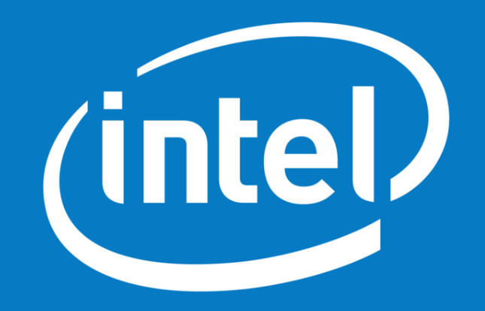
Broadcom: First to Commercialize CPO with a Sustained Lead
Competitive Positioning: ≈1-year lead over ​NVIDIA;
The only vendor with publicly confirmed mass production of CPO switches/chips;​
TH4 & TH5: Industry’s first CPO switch chips to enter volume production.
Timeline of CPO Switch Chip Milestones¹ (2020–2025)​
ASIC
Capacity（Tbps）
Broadcom edge
~1 year
102.4
TH6
Spectrum 6
25.06
Mass production
26
Mass production
51.2
TH5
TH5
TH5
Spectrum 5
Announced
Demo
Mass production
Announced
Mass production
Teralynx
Teralynx10
Demo
Mass production (not CPO)
25.6
TH4
TH4
Announced
Joint Deployment
12.8
WEDGE
Demo
2020
2021
2022
2023
2024
2025
Source: Broadcom, Nvidia, Intel, Cisco, Marvell;
¹Note: CPO switch chips prioritized in timeline.

Slide 5




Broadcom: The Most Comprehensive CPO Capability Profile
Broadcom leads the CPO ecosystem with strongest capabilities.
Capability Profile of Integrated Giants Across the CPO Value Chain¹
High
Medium
Low
Broadcom | Nvidia | Intel | Cisco | Marvell
高 | 高 | 高 | 中 | 中
高 | 高 | ​高 | 中 | 中
高 | 高 | 高 | ​中 | 低​
​高​ | 中 | 低 | 低 | 低
Design
Foundry
Assembly & Test
Final
Packaging
Source: Broadcom, Nvidia, Intel, Cisco, Marvell;
¹Note: Not an exhaustive list; focusing on key partners.​

Slide 6
Why Broadcom Bets on CPO: Aligning with HPC's In-House ASIC Trend + Network Support for Ecosystem Positioning
① ASIC: The inevitable trend. Broadcom plays a central role.
HPCs seek computing autonomy & cost control​ → More players partner with Broadcom;
​​OpenAI, xAI: New volume production orders in 2026 will ​bring forward the “ASIC > GPU” inflection point from 2027–28 to 2026.
Shipment Portion（%）
2025E Main ASIC Vendors’s Shipment
26E, ASIC surpass GPU
100-300k units
Meta
Amazon
MSFT
Intel
1400-1500k units
>33
Amazon
Amazon
MSFT
Intel
Google
Meta
ByteDance
OpenAI
xAI
Google
Meta
ByteDance
Google
1500-2000 units
ASIC
GPU
Broadcom ASIC
Source: Nomura Securities, J.P.Morgan, Fubon Research, BNP

Slide 7
Why Broadcom Bets on CPO: Aligning with HPC's In-House ASIC Trend + Network Support for Ecosystem Positioning
② ASIC: Weaker per-card performance, requiring optical interconnect & CPO when scaling.
Top ASIC per-card performance ≈ ​40% of same-gen GPU​ (similar to domestic Scale-up logic);
Cloud ASICs expected to drive ​~80% of transceiver market growth; leaders like ​Google, Amazon​ now evolving toward ​CPO.
BF16/FP16 (TFLOPS)
AMD-MI355X
GB200
AMD-MI350X
46%
AMD-MI325x
B200
Google-​TPU v7p​
H100-SXM1
H200-SXM
Intel-Gaudi3
Reserving CPO interfaces
34%
42%
AWS-Trainum3
Intel-Gaudi2
AWS-Tranium2
Google-TPU v6e
Ascend 910C
Ascend 910B
A800-SXM
Meta-MTIA V1
Google-TPU v5p
Meta-MTIA V2
22
23
24
25
26
GPU
ASIC/xPU
General-Purpose Compute Card
Huawei
Year of Mass Production
Source: Fubon Research, Semiconductor Research, LightCounting

Slide 8


FiconTEC: Key Player for Domestic Substitution in CPO
Market Position: One of the very few global supplier for automated SiPh/CPO module assembly & test;
​Prospects: Unmatched high-precision packaging capability, crucial for CPO era.
Roadmap: Filling a key domestic technology gap
Business: Dominator of micro-assembly & automated testing
Revenue Breakdown (2023A)
2025
Acquired 100% by Chinese listed company Robotechnik for RMB 1.01bn.
2025.06
Test, clean, and repair all-in-one
Test Equipment, etc.
2023
Robotechnik announced a plan to acquire 100% of ficonTEC.
2021
Micro-assembly
World-leading accuracy
2002
Seed-round investment.
2001
Founded in Germany.
ASSEMBLYLINE Series
Source: Robo-Technik

Slide 9





FiconTEC: Key Player for Domestic Substitution in CPO
Profitability
Upstream & Downstream
Gross margin: ~40%, exceeds the industry average for assembly and test (approx. -30%);
Losses: continue to narrow.
Delivery：Low-volume, high-price, heavy on delivery.
RMB
2.35mn
700+ units
Capacity 94 units
Output 80 units
Sales 96 units
85%
$0.1bn
Capacity Utilization Rate
ASP
Global Delivery
Customers & Suppliers: Concentrated.
Customer Proportion
Supplier Proportion
CR5
Tech Group AS
Standard- hardware
Source: Robo-Technik

Slide 10







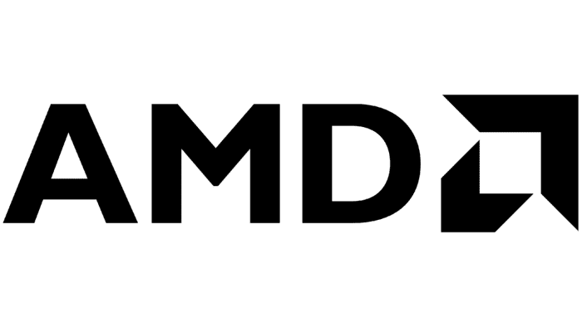


CPO Startups Comparison: Ayar Labs, Lightmatter, Celestial AI
2015_{US}
2020_{US}
2017_{US}
Business
&
Products
OIO Chiplet
​Optical Full-Stack Solutions
CPO/OIO Passage Interposer
512Gbps OIO bandwidth
Ultra-low power: 4.9pJ/bit
Card：PFLink，14.4 Tbps/die
Switch：PFSwitch
Proprietary silicon photonics chip
Package-level solution
TeraPHY
Photonic Fabric
Passage Series
Funding
1B
2024.12 Series D: $155mn
2.5B
2025.02 Series C1: $250mn
4.4B
2024.10 Series D: $400mn
Strategic Investor
Advantages
Technology integrated into PCIe 6.0 standard;
Ecosystem barrier.
Systematic OIO with long R&D cycle;
Cross-layer solution.
Compatible with Broadcom;
Abstracts packaging layer into hardware (controllable delivery).
Progress
POC => Mass Production
Certify => Design-in / Early Proto
Certify => Design-in
2024.10：Shipped 15k chiplets in the past 18 months;
26E：First high-volume customers.
25H2: Sampling starts,
2027: mass production.
2025 Summer: interposer shipment;
2026: L200 CPO chiplet shipment.

